Slide 1

Predictive Analytics for Customer Churn

Slide 2

AGENDA
Introduction
EDA & Building a Churn Prediction Model
Conclusion

Slide 3

iNTRODUCTION
In the home test I will use Python as the main tool for the following steps:
Data wrangling
EDA
Model Selection

Slide 4
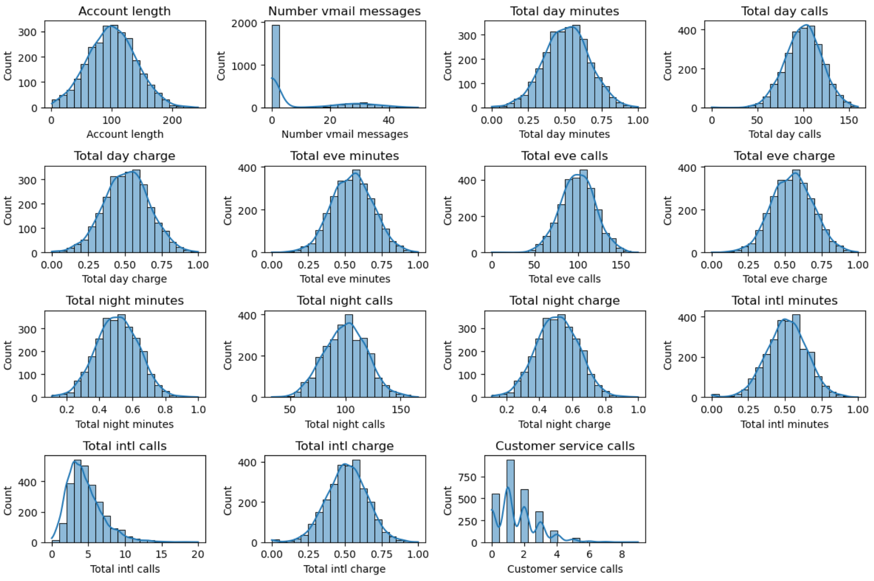
EDA & Building a Churn Prediction Model
After wrangling data, I decide to categorize the data into 2 types: categorical & numerical data for further investigation.
The data were mostly normal distributed except for total int calls, customer service calls, number vmail messages. I then using Paired Comparison Analysis to work out the relative importance, thus choosing the most importance data to analyse.
This is a powerful tool in public speaking. It involves varying pitch, tone, and volume to convey emotion, emphasize points, and maintain interest.
Pitch variation
Tone inflection
Volume control

Slide 5
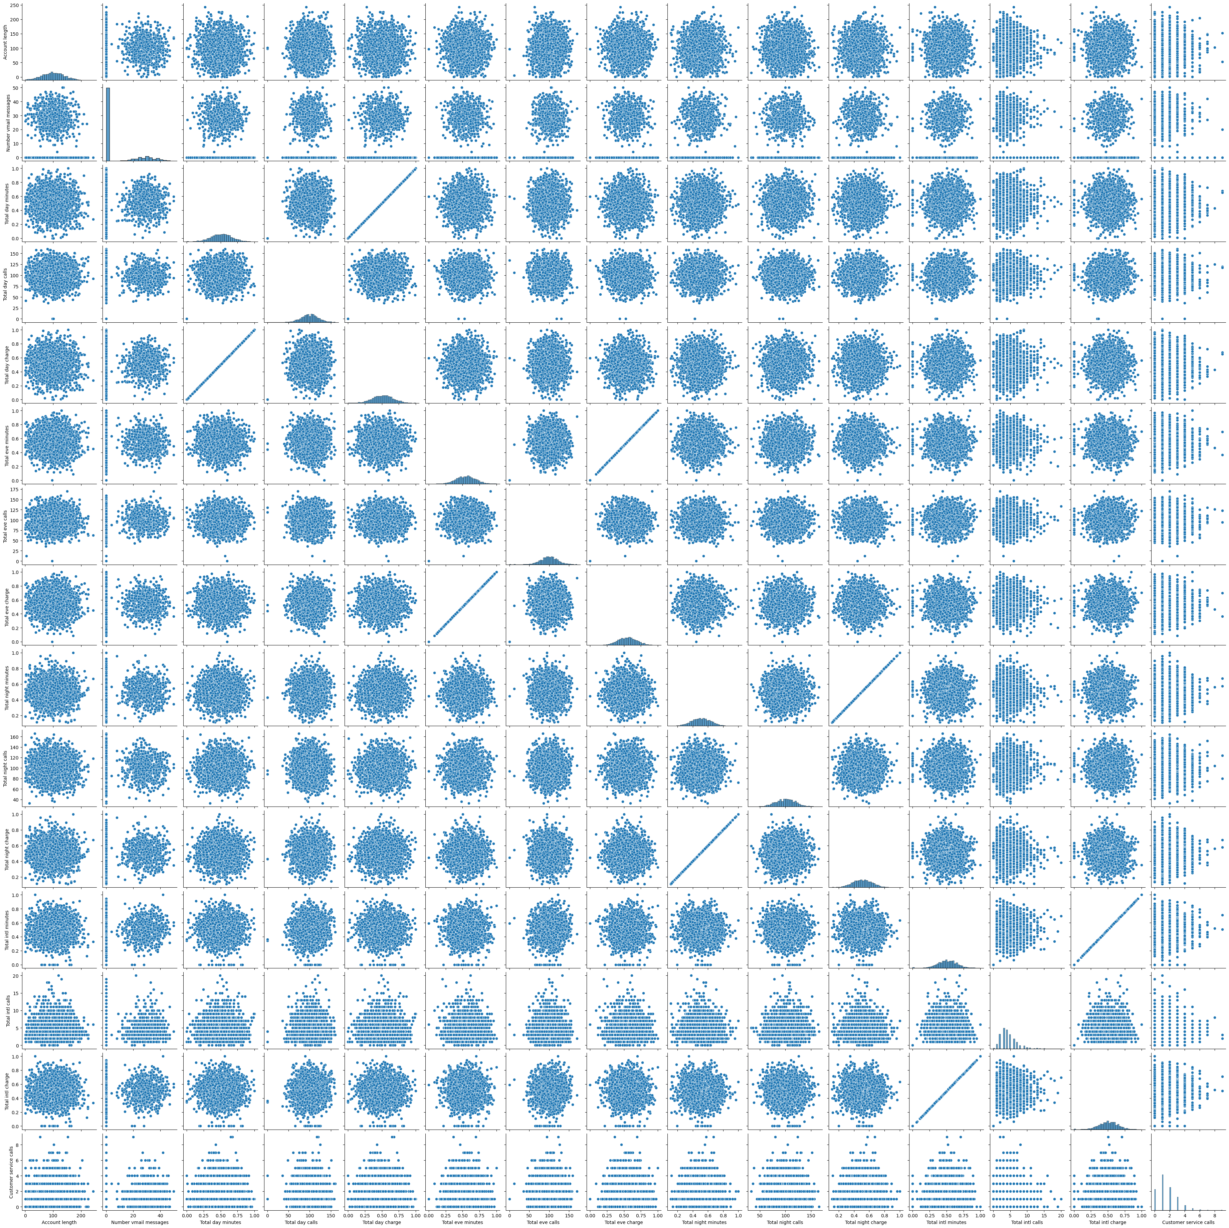
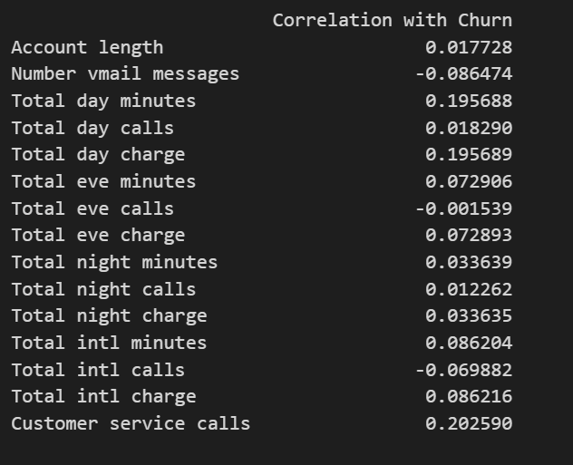
NAVIGATING Q&A SESSIONS
There are linear correlation between total minute and total charge (which is obvious). Most of the correlation with churn is also low (-0.3<corr<0.3), but customer service calls so the highest correlation
Know your material in advance
Anticipate common questions
Rehearse your responses

Slide 6
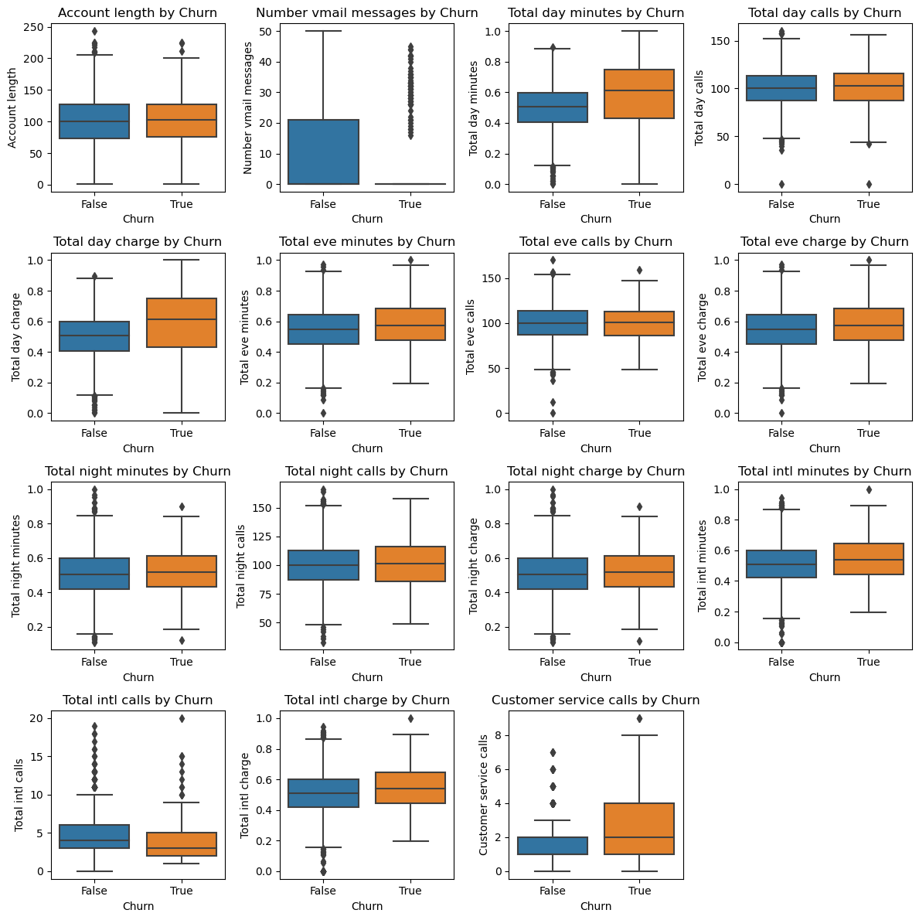
From the box plots, we observe a comparable usage frequency between churned and non-churned customers across most features. However, upon closer examination of "customer service calls by Churn," a distinct pattern emerges. Churned customers exhibit a notably higher usage of customer service calls compared to those who don't churn.
This leads us to hypothesize two potential scenarios:
Customer Service Quality: The elevated frequency of customer service calls among churned customers may suggest dissatisfaction with the quality of our customer support. It's plausible that unresolved issues, prolonged wait times, or unsatisfactory interactions with support staff contribute to this dissatisfaction.
Service Usability and User Experience: Alternatively, the disparity in customer service call usage could indicate challenges in navigating or utilizing our service. Churned customers might encounter usability issues, confusing interfaces, or other usability barriers that prompt them to seek assistance more frequently. This scenario suggests that our service may be less intuitive or user-friendly compared to alternatives in the market

Slide 7
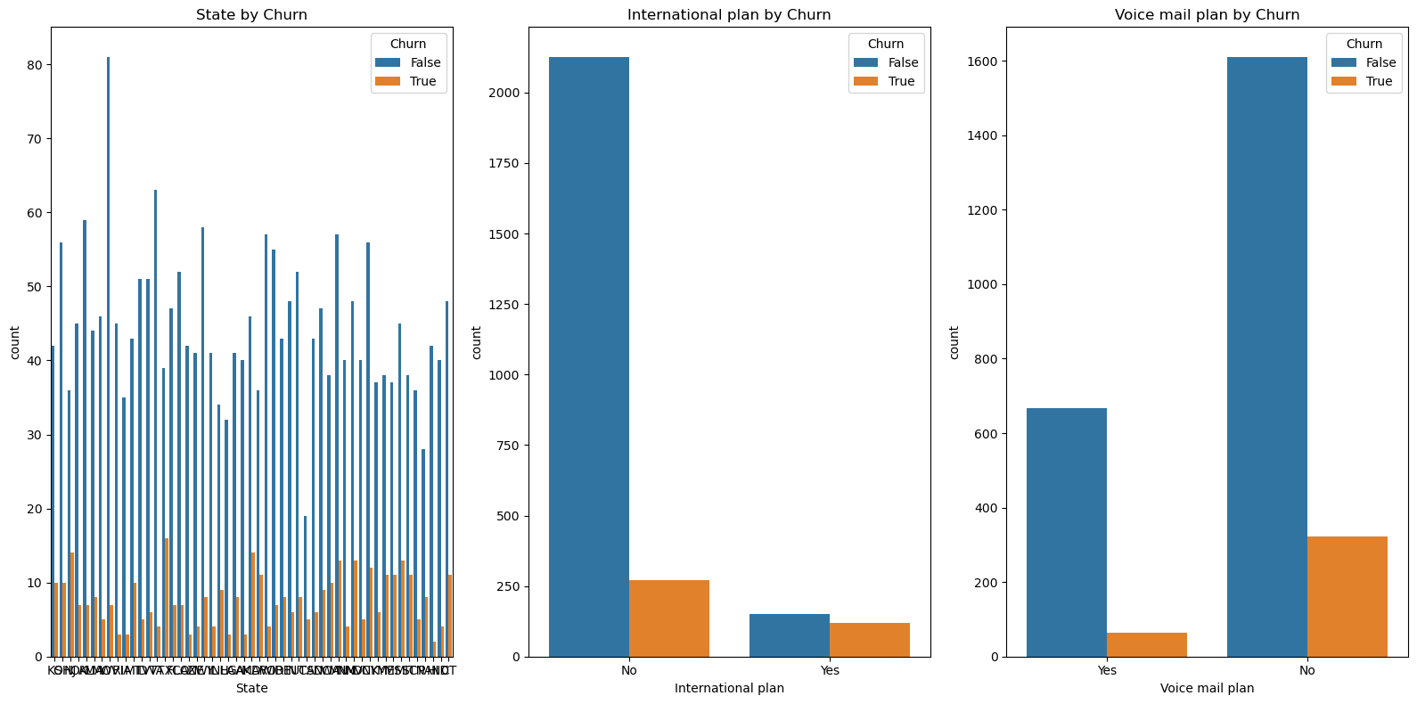
- There are some state with higher churn rate also have lower stay rate => this might be regional problems
- The churn rate is lower with people using voice mail => Our voice mail features might work well and it can become one of our USPs.
- The opposite trend happens with international plan. We might want to look into the ROI of this feature and how it performs

Slide 8
Building a Churn Prediction Model
I choose these ML models:
- Linear Regression
- Polynomial
- Decision Tree
- Logistic Regression
- Random Forest
- Gradient Boosting
How I build ML models:
- Initiate model features & fit the training data
- Testing with test data
- Generating R-squred & RMSE for further comparision

Slide 9
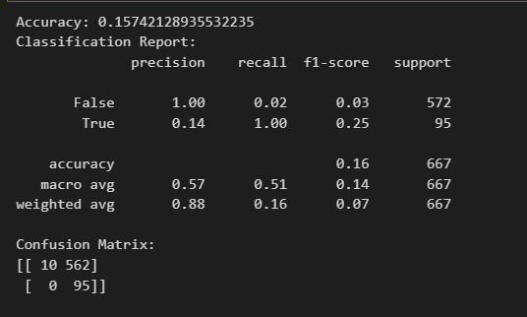
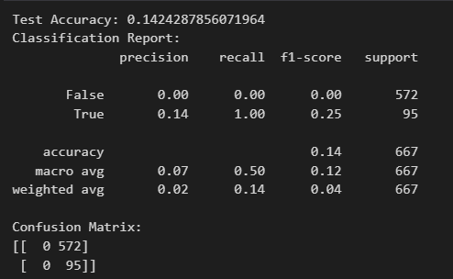
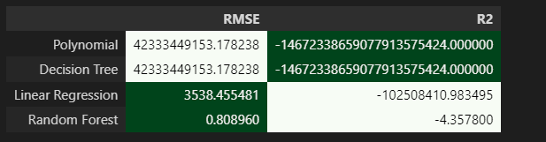
The outPuT
Gradient Boost
Logistic Regression

Slide 10
Conclusion
Random Forest has the highest R2 and lowest RMSE. However, R2 is only approximately 0.5, which indicates that Random Forest model seems to have achieved a moderate level of predictive performance.
=> I would suggest using Gradient Boosting (Accuracy: 0.93) for further model development
Besides, from insights I gained after visualizing data, there are few steps I suggest to find the root cause behind the churn:
- Analyse customers' feedback/satisfaction surveys related to customer service
- Usability testing, user feedback sessions, and analyzing user behavior data

Slide 11

THANK YOU
Tran Mai Linh
0978278924
Tranmailinh.forwork@gmail.com

